Slide 1
Tutorial 3 Market Structure

Slide 2
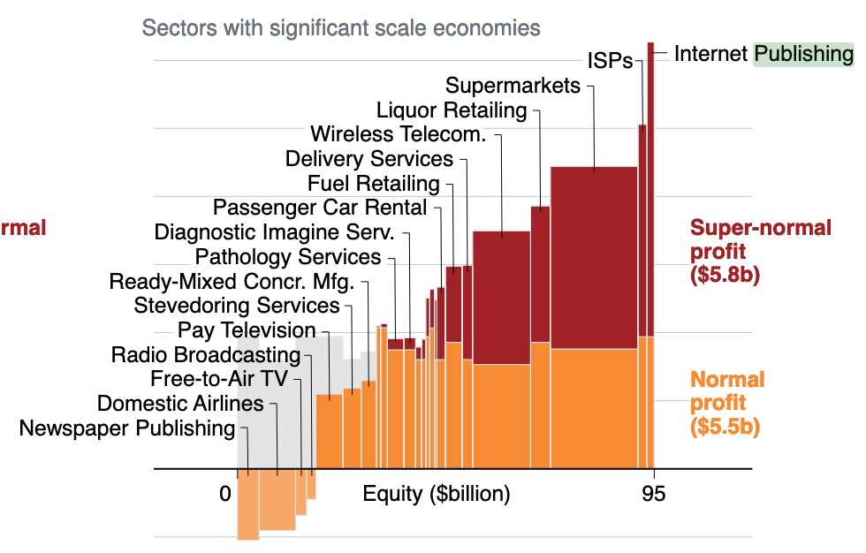
Question 2

Slide 3
Question 4

Slide 4
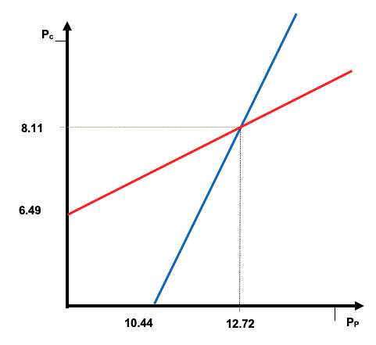
Question 5

Slide 5
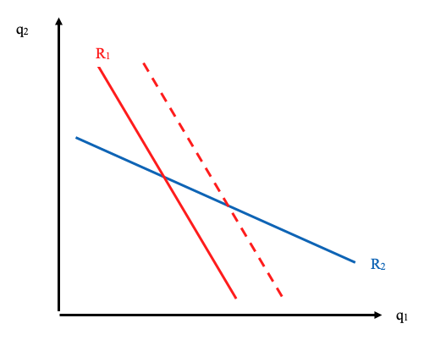
Question 6

Slide 6
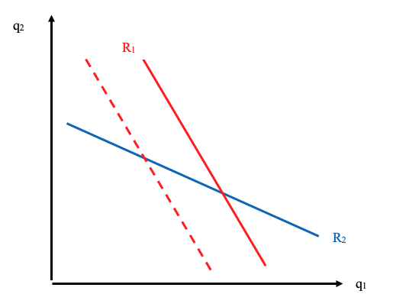
Question 6

Slide 7
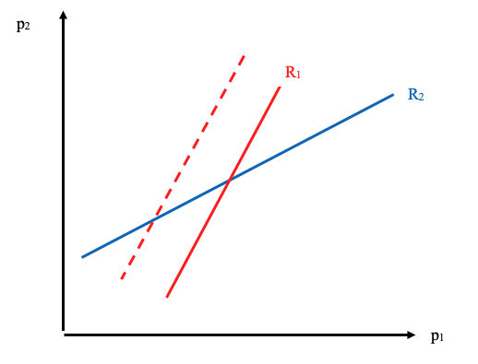
Question 6

